Slide 1


Mobile Application Development Laboratory
TRUTHDARE: SPIN THE BOTTLE FUN GAME
2116220701197
N.PRANNOV SHABARI
Mr. Bhuvaneswaran B, M.E.
Supervisor

Slide 2
Abstract
Truth or Dare MAD is an interactive and engaging mobile application that recreates the timeless fun of the "Spin the Bottle" game for the digital era. Designed primarily for Android devices, the application delivers a lively gaming experience where users spin a virtual bottle and are prompted to choose between two options: "Truth" or "Dare." Players can respond to a wide selection of preloaded questions and challenges or enrich the game by adding their own customized truths and dares, ensuring a unique and personalized experience each time. The application focuses on delivering a smooth, realistic bottle-spinning animation and a highly intuitive user interface following modern mobile UI/UX best practices. Emphasis has been placed on ease of navigation, responsive design, and dynamic content management to maximize user enjoyment. TruthDare MAD is lightweight, ensuring high performance even on devices with modest specifications. From a technical standpoint, the project demonstrates essential mobile application development skills, such as event-driven programming, animation handling, user data management, and persistent storage through local databases (SQLite). Future expansion possibilities, including multiplayer support and enhanced gamification features, position TruthDare MAD as not just a casual party app but a scalable, customizable platform for entertainment.

Slide 3
Need for the Proposed System
The traditional Truth or Dare game has been a popular social activity for decades, often played using a physical bottle to select players at random. However, with the growing prevalence of smartphones and digital platforms, there is an increasing demand for modern, portable, and hygienic alternatives to such physical games. The proposed system, a Truth or Dare Spin the Bottle Android application developed using Kotlin, addresses this need by digitizing the experience, making it more accessible and engaging for users.
The key motivations for this system include:
Convenience and Accessibility: Unlike the physical version, the mobile app can be played anywhere and anytime without the need for props.
Randomization Accuracy: The digital spinning logic ensures fair and unbiased player selection, enhancing the gameplay experience.
Customization and Variety: Users can add their own truth and dare challenges, allowing for a more personalized and dynamic game.

Slide 4
Advantages of the Proposed System
Portability
The app can be used anywhere and anytime on a smartphone, eliminating the need for carrying a physical bottle or game setup.
Fair and Unbiased Selection
The digital spinning mechanism ensures random and fair player selection, avoiding disputes common in the physical version.
Hygienic and Safe
As there is no need to physically spin a shared bottle, the app offers a hygienic alternative, especially important in post-pandemic times.
Customizable Gameplay
Users can easily add, edit, or remove truth and dare questions, allowing for personalized and endlessly varied game sessions.
Enhanced User Experience
Features such as sound effects, animations, timers, and different difficulty levels make the game more engaging and entertaining.
No Setup Required
Instant playability without the need for physical arrangements makes it ideal for spontaneous gatherings or online group sessions.

Slide 5
Main Objective
The main objective of this project is to design and develop an innovative, interactive, and user-friendly Truth or Dare Spin the Bottle mobile application using Android development in Kotlin. This application aims to modernize the classic social game by providing a digital platform that offers convenience, portability, and enhanced entertainment value for users of all ages.
By eliminating the need for physical objects like a spinning bottle, the app provides a safe, hygienic, and accessible alternative that can be used anytime and anywhere. The core functionality revolves around a virtual bottle spin mechanism that randomly and fairly selects players, thereby maintaining the excitement and unpredictability of the traditional game.
Furthermore, the system aims to offer high levels of customization by allowing users to add, edit, or remove truth and dare challenges, ensuring a personalized and dynamic gameplay experience. Additional features such as engaging animations, sound effects, difficulty levels, and timers are integrated to enrich the user experience and make the game more interactive and enjoyable.
The application is built using Kotlin and follows modern Android development practices, ensuring efficient performance, smooth navigation, and compatibility with a wide range of Android devices. Ultimately, this project seeks to provide a scalable and feature-rich mobile solution that not only preserves the essence of the traditional Truth or Dare game but also elevates it with the capabilities of digital technology.

Slide 6
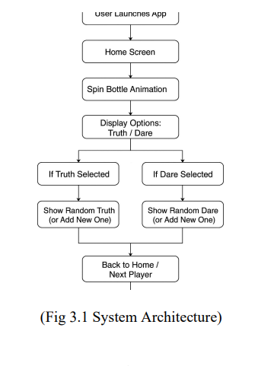
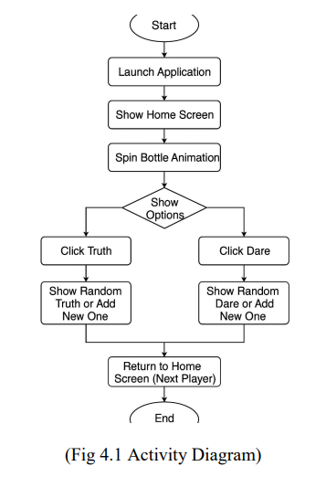
Architecture

Slide 7
System Requirements
Hardware Requirements
Smartphone Device
  Minimum: Android 7.0 (Nougat) or higher
  RAM: 2 GB or more
  Storage: At least 50 MB free space
  Processor: Quad-core or better
Development Machine (for Developers)
  Processor: Intel i5 or equivalent (minimum)
  RAM: 8 GB or more
  Storage: 500 GB HDD or 256 GB SSD (Recommended)
  Operating System: Windows 10/11, macOS, or Ubuntu

Slide 8
System Requirements
2. Software Requirements
Development Tools
  Android Studio (version Arctic Fox or newer)
  Kotlin Plugin (Bundled with Android Studio)
  Gradle Build System
Operating System (Development Environment)
  Windows 10 or higher
  macOS Mojave or higher
  Ubuntu 18.04 LTS or higher
Android Device (for Running the App)
  Android version 7.0 (Nougat) or later
  Google Play Services (optional, if integrating ads or analytics)

Slide 9
Functional Description
Core Functionality
Virtual Bottle Spinner: Simulates the classic "Spin the Bottle" game with realistic animations.
Truth or Dare Prompts: Offers a variety of preloaded and customizable truth questions and dare challenges.
User Interaction: Players take turns spinning the bottle and responding to the prompted truth or dare.
Custom Content: Allows users to add their own truth and dare entries for a personalized experience.
User Interface & Experience
Intuitive Navigation: Designed for ease of use, ensuring a smooth user journey.
Responsive Design: Optimized for various screen sizes and orientations.
Dynamic Content Management: Enables seamless updates and additions to game content.

Slide 10
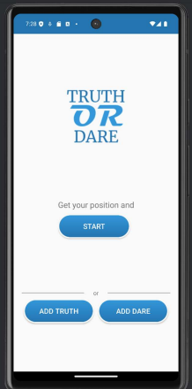
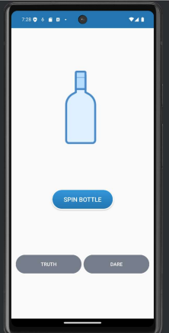
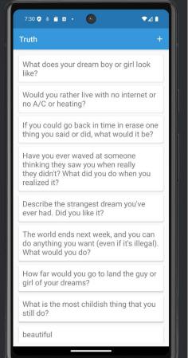
Implementation

Slide 11
Conclusions
In conclusion, TruthDare MAD successfully revitalizes the classic "Spin the Bottle" game for the digital age, offering an engaging and customizable experience for Android users. By integrating a realistic spinning animation, intuitive user interface, and the ability to add personalized content, the application ensures each session is unique and enjoyable. The project's development showcases proficiency in key mobile application development areas, including event-driven programming, animation handling, user data management, and persistent storage using SQLite. Looking ahead, planned enhancements such as multiplayer support and advanced gamification features position TruthDare MAD as a scalable and versatile platform for interactive entertainment. Overall, the application not only delivers a fun party game experience but also demonstrates a solid foundation for future growth and innovation in mobile gaming.

Slide 12
Future Enhancement
1. Multiplayer Functionality
Online Multiplayer: Implement real-time online multiplayer capabilities, allowing users to create or join game rooms with friends or other players globally.
Offline Multiplayer: Facilitate local multiplayer sessions where multiple users can play on the same device or through local network connections.
2. AI-Generated Content
Dynamic Prompt Generation: Integrate AI to generate personalized and context-aware truth and dare prompts, ensuring a unique experience each time.
Adaptive Difficulty: Employ AI to adjust the complexity of questions based on user interactions and preferences.
3. Gamification Elements
Achievements & Badges: Introduce a system where players earn rewards for completing challenges, encouraging continued engagement.
Leaderboards: Display top players or groups, fostering a competitive environment.

Slide 13
References
1. GitHub - TruthorDareApp/Truth-or-Dare: Social gaming app allowing users to play Truth or Dare online with others.
https://github.com/TruthorDareApp/Truth-or-Dare
2. IJRASET - Truth or Dare an Android Gaming App: Research paper discussing the adaptation of Truth or Dare games to mobile platforms.
https://www.ijraset.com/research-paper/truth-or-dare-an-android-gaming-app
3. Academia.edu - Truth or Dare an Android Gaming App: Academic paper exploring the development process and user impact of a Truth or Dare app.
https://www.academia.edu/105215048/Truth_or_Dare_an_Android_Gaming_App
4. Android Ally - 9 Best Truth or Dare Apps for Android in 2025: Article reviewing top Truth or Dare apps available on the Play Store.
https://www.androidally.com/best-truth-or-dare-apps/
5. Androidsis - The 6 best truth or dare applications for Android: Compilation of popular Truth or Dare apps with various features and challenges.
https://en.androidsis.com/truth-or-dare-apps/

Slide 14
Thank You…!

